Slide 1



V-Grub
Establishing Essential Commodities Supply Using Ecommerce
This project utilizes ReactJS, Bootstrap/Tailwind CSS for front-end, MongoDB for dataset maintenance, Django for backend and Razor pay for integrating payments. With a product recommendation system, the site sells munchies, fruits, and medicine, solving the local vendor's business opportunity problems at VIT Bhopal University.
Shaurya Thapliyal (22BAI10085) [Machine Learning]
Kaushal Sengupta (22BAI10102) [Front End]
Abhishek Choudhary (22BAI10072) [Back End]
Aditya Attri (22BAI10176) [Dataset Maintainer]
Pari Agrawal (22BAI10142) [UI/UX]

Slide 2

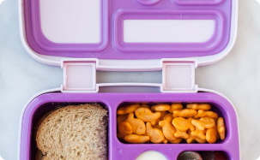


Introduction
Target Audience
Features
Technology
Our website targets the student body, faculty, and small business owners in and around VIT Bhopal University.
Along with the supply chain management solution, our website provides healthy product options like fruits and medicine and offers the convenience of food items like chocolate and chips.
Our website uses a responsive design that is built using ReactJS, MongoDB, and Razorpay to ensure smooth user experience and payment integration.
Tools
Bootstrap/TailwindCSS is used to implement a responsive design with efficient CSS and HTML, and Git for version control management.

Slide 3




Problems In The Current System
Problem Statement
Solution
Problem - Cash Management
Solution - Online Payment Integration
Our website offers VIT Bhopal College students a 24/7 solution by providing a variety of food options, including healthy choices like fruits and dry fruits, to cater to their late-night cravings.
The deficiency in supply chain management at VIT Bhopal University leads to a critical absence of late-night eateries, a pressing need for nocturnal students that remains unmet within the campus.
The old-fashioned cash transactions at the university premises often lead to hassle and confusion due to high number of transactions.
The e-commerce site allows online payment integrations with Razor Pay to ensure a safe, secure, and user-friendly payment experience.

Slide 4

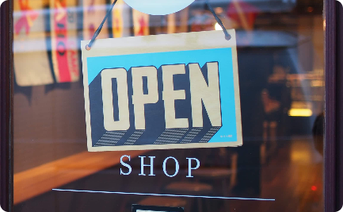

Efficient Stationary Delivery for Students
Problem - Limited Availability
Problem - Inconvenient Store Hours
Solution - 24/7 Access
Our online store is available 24/7, so students can order their supplies at any time that is convenient for them.
Students often struggle to find essential stationary items like pens, pencils, and notebooks on campus.
Many campus supply stores have limited hours, making it difficult for students to purchase the supplies they need.

Slide 5


Current Existing Technologies
In today's digital age, e-commerce giants like Amazon and Flipkart have revolutionized the way we shop by offering a vast array of products at our fingertips. However, a common concern for consumers is the additional delivery charges associated with purchases on these platforms. These fees can substantially raise the final cost of your order, making the convenience of online shopping less appealing.
Our college project seeks to address this issue by providing an alternative platform that offers the same products found on Amazon and Flipkart but at more affordable rates. What sets us apart is our commitment to ensuring swift delivery within just a few hours, rather than the typical wait of several days. This means that you can enjoy the convenience of online shopping without the frustration of extended delivery times and excessive costs.
Our aim is to create a seamless and cost-effective shopping experience for consumers, bridging the gap between convenience and affordability in the online retail landscape. By doing so, we hope to make online shopping not only accessible but also more enjoyable for everyone.

Slide 6

Defining Our Dataset
Our comprehensive dataset for our e-commerce platform is designed to cater to the diverse needs of VIT Bhopal University students, offering a wide range of products at affordable prices. This dataset encompasses an assortment of munchies, spanning from chips to biscuits, along with stationary supplies and farm-fresh fruits. What sets our platform apart is our dedication to supporting the local economy by partnering with local vendors.
Our collaboration with these vendors is built on a commission-based model, where they receive a percentage of the sales generated through our platform. This not only incentivizes them to provide high-quality products but also promotes local businesses and livelihoods.
In our dataset, you will find a variety of munchies, ensuring that students have access to their favorite snacks and quick bites. Additionally, we offer stationary supplies, addressing academic and personal needs. The inclusion of farm-fresh fruits aligns with our commitment to promoting healthy living and supporting local agriculture.
Our goal is to create a convenient and cost-effective shopping experience for students, while also fostering positive relationships with local vendors. By offering these products at nominal rates and ensuring a fair commission system, our e-commerce platform aims to become an integral part of the VIT Bhopal University community, benefiting both students and local businesses. We believe that our initiative will enhance the overall quality of life for the university's diverse student body.

Slide 7
Database Management

Slide 8

Personalized Recommendations with Collaborative Filtering Algorithm
Collaborative filtering is a powerful algorithm for providing personalized recommendations to users.
We are going to apply User-Based Collaborative Filtering which recommends products to users based on the preferences and behaviour of users with similar tastes.
We are also going to implement Item-Based Collaborative Filtering which recommends products similar to those a user has shown interest in.
For Implementations of these Machine Learning Algorithm's we are going to utilize Pandas and Sklearn Modules of Python.

Slide 9
Business Model
1
Core Idea
The business model revolves around connecting local vendors with the students and faculty of VIT Bhopal University while providing healthy and convenient products. In the future, we plan to add prepared food to our inventory.
2
Revenue
The platform will charge vendors a specific commission amount for every item sold. We also have plans to partner with health and fitness brands and launch a subscription box service.
3
Growth Strategy
We aim to bring pre-processed food also because we understand the cravings that strike late at night, especially when the campus eateries have closed their doors.
4
Tools Required
A website or app for the platform
A payment gateway to handle transactions
An inventory management system to track prices of products and our cut-margin.
A delivery system to transport products to customers
5
Benefits - Convenient Delivery
Due to safety restrictions, college students often cannot leave the main gate to go to local stores. With our website, vendors can come in and deliver products directly to the students.

Slide 10
Our Workflow
UI/UX Design
We are going to make a clean minimalistic UI.
Front End Creation
We are going to bring life to our UI using HTML CSS and React.js all while making it responsive for both desktop and mobile users.
Back End Deployment
Maintaining and managing our dataset using MongoDB and integrating it with our Front End.
Apply Machine Learning
We are going to apply collaborative Machine Learning Algorithm for enhancing User Experience.
Integrating Payment Gateway
Vendor Integration
Adding payment gateway for hassle free payments using Razor Pay .
Contacting vendors and creating a commission based contract with them.
Hosting Our Website
Finally we deploy our website on a web hosting service like Heroku or Cyclic.

Slide 11
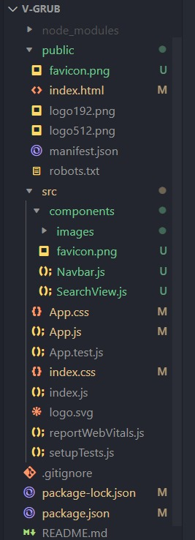
Project Directory

Slide 12
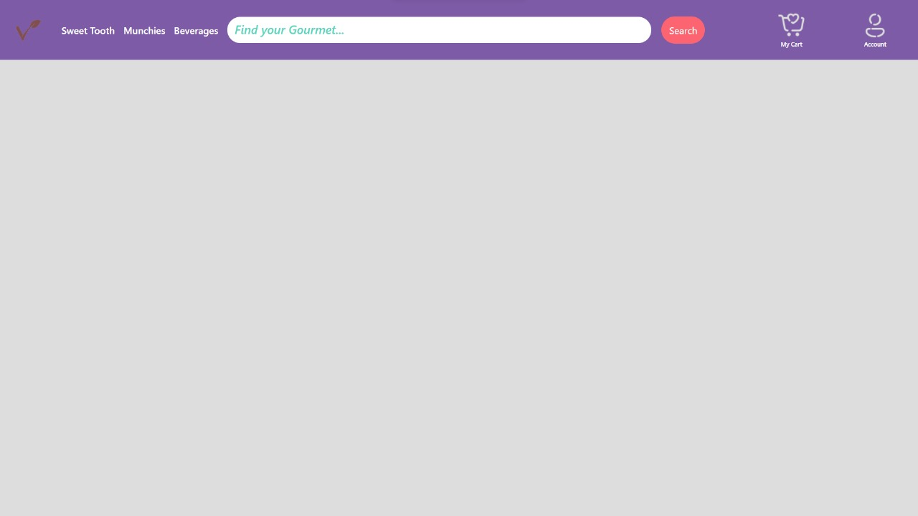
Website Frontend

Slide 13
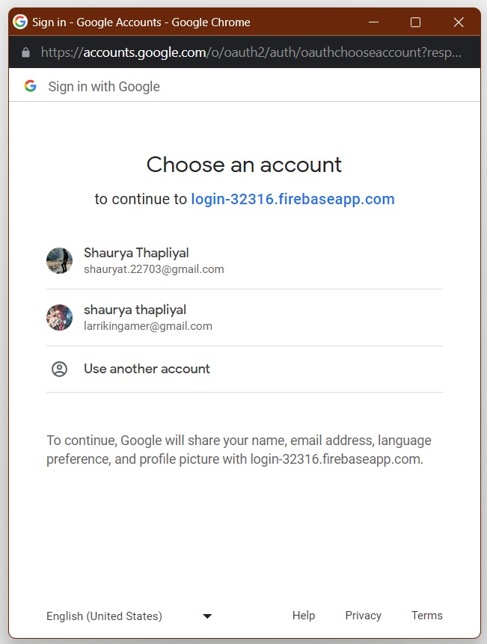
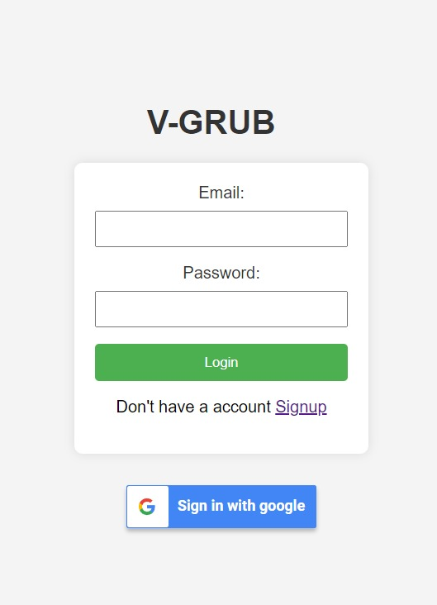

Slide 14
Tools used in Frontend
React: React is a free and open-source front-end JavaScript library for building user interfaces based on components. React can be used to develop single-page, mobile, or server-rendered applications with frameworks like Next.js. Because React is only concerned with the user interface and rendering components to the DOM, React applications often rely on libraries for routing and other client-side functionality.
Bootstrap: Bootstrap is a free and open-source CSS framework directed at responsive, mobile-first front-end web development. It contains HTML, CSS and JavaScript-based design templates for typography, forms, buttons, navigation, and other interface components. we have used boot strap for creating various button svg and sixing different container.

Slide 15
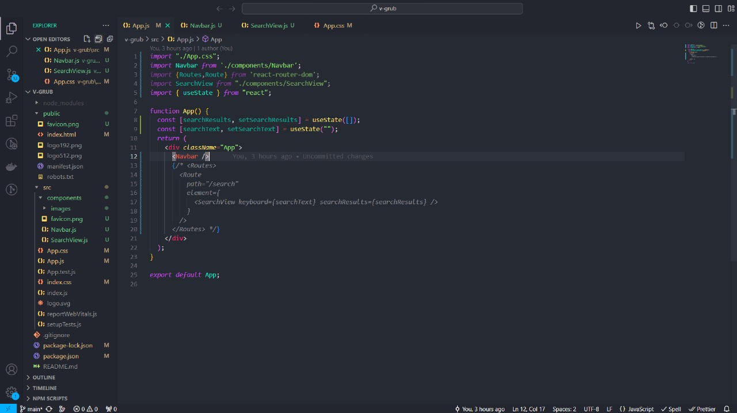

Slide 16
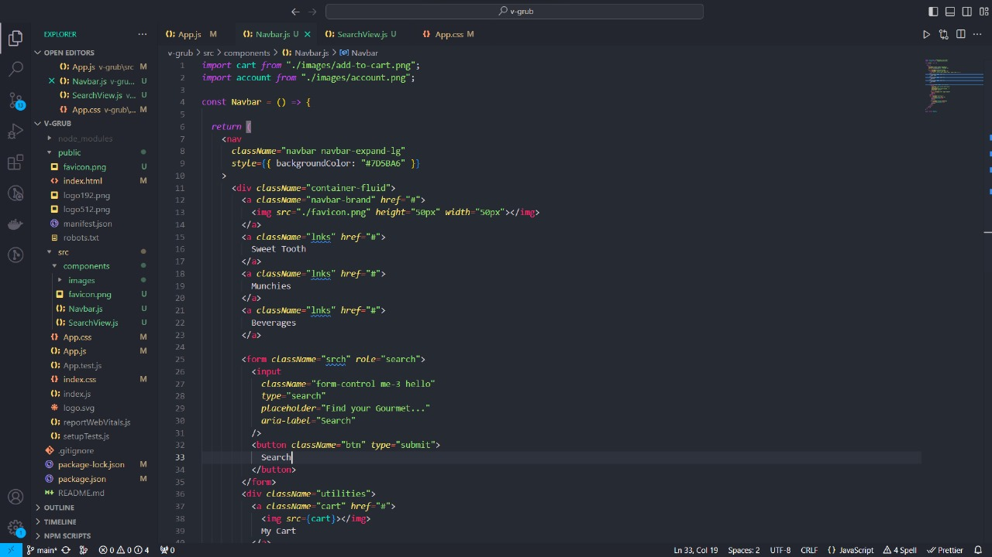

Slide 17
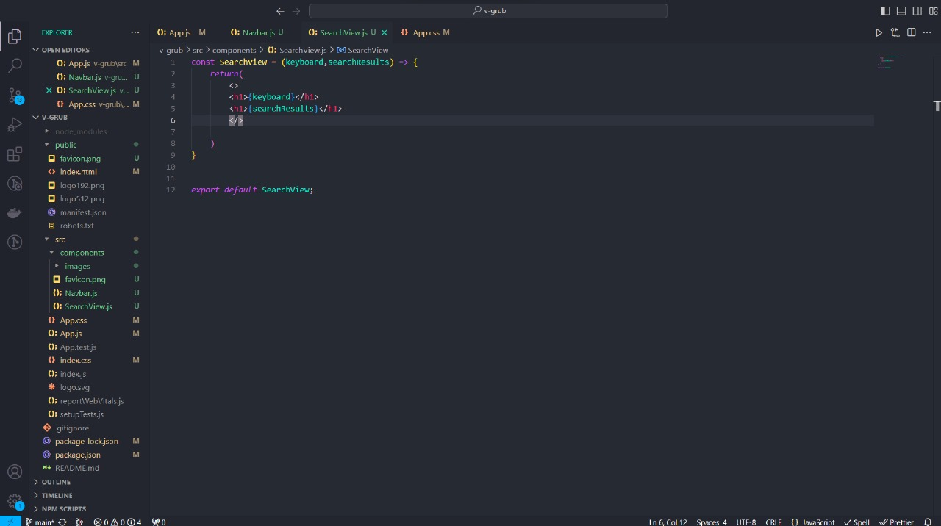

Slide 18
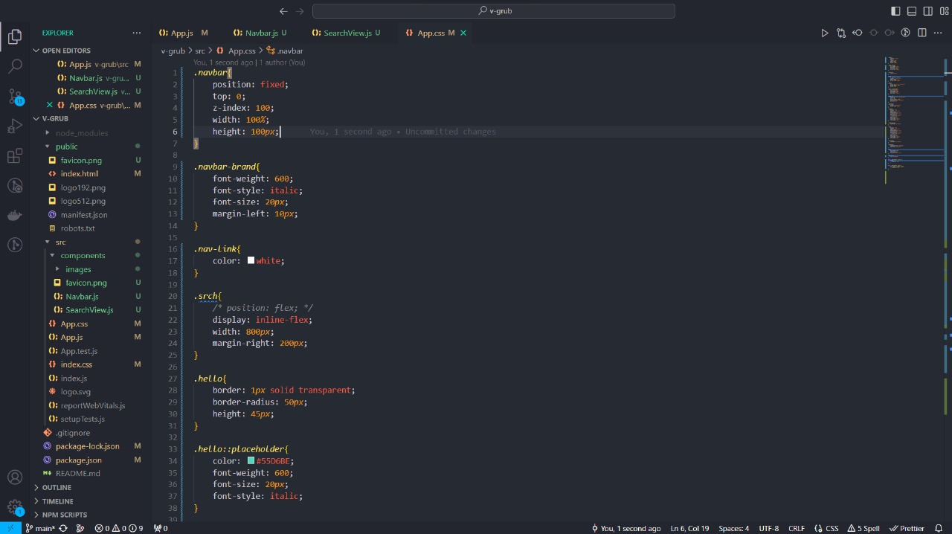

Slide 19
Tools used for Backend development
Node.js: Node.js is a cross-platform, open-source server environment that can run on Windows, Linux, Unix, macOS, and more. Node.js is a back-end JavaScript runtime environment, runs on the V8 JavaScript engine, and executes JavaScript code outside a web browser.

Slide 20
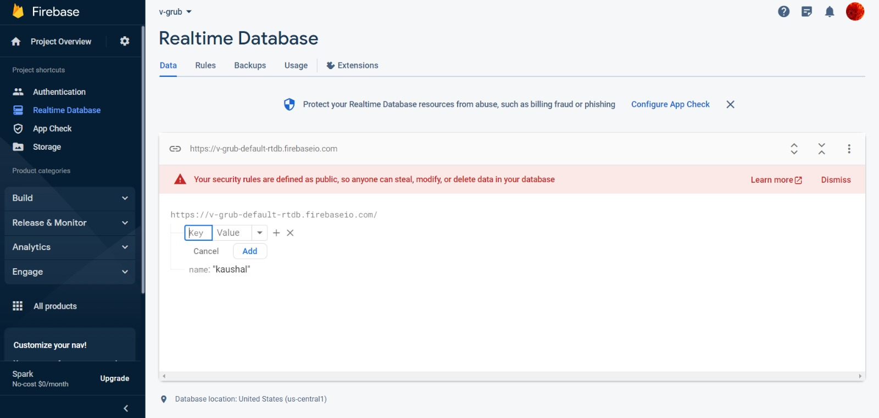
Firebase for Database Management

Slide 21
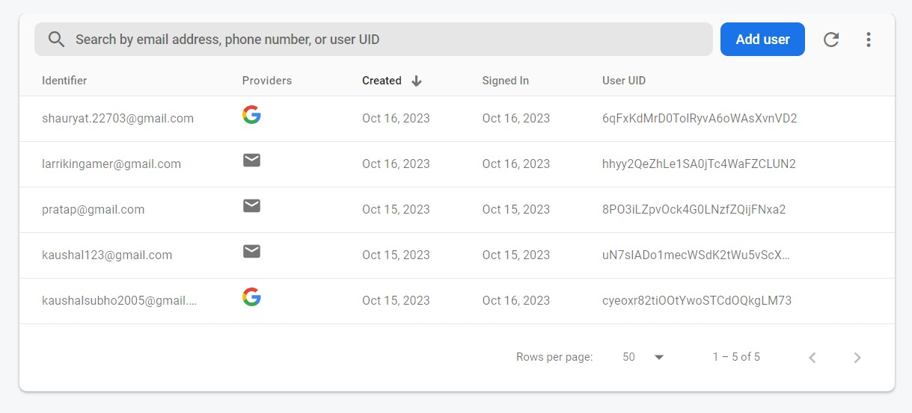
Firebase
Firebase Authentication is a service provided by Google Firebase that enables developers to add user authentication to their web applications easily we are using firebase authentication system to help user login or sign up to his/her account in our website.

Slide 22

Thanks and Regards,
~Team: V-Grub

